Slide 1

Recipe Finder Application
Team CTR:
Chantel Hoskins, Talia Ortiz, Roland Gonzales

Slide 2
The Process of Choosing an Application
Apps up for debate:
Car Info Lookup
Event Finder
Recipe Finder App
Trivia Game
Random Quote Generator
Weather App
Pet Care Tracker
Plant Care App
A detailed list of these application ideas including the evaluation and categorization can be examined further on the ‘BRAINSTORMING.md’ text file located on the ‘Milestone-1’ repo.
All documentation was created by Talia Ortiz.

Slide 3
Top 3 Apps
Recipe Finder App: The recipe finder app would suggest recipes after the user provides their available ingredients. Recipes would be fetched from a public API like Spoonacular. The app could also allow the user to save their favorite recipes.
Trivia Game: The app fetches trivia questions and displays them in a quiz format using RecyclerView. We would provide multiple-choice answers and show results at the end of the quiz. We could add difficulty levels or themes like science, history, etc.
Pet Care Tracker: The pet care app would create profiles for your pets to keep vital and dietary information, track vet appointments, upcoming vaccinations, weight tracking, etc.

Slide 4
Chosen Application – Recipe Finder App
Description: The recipe finder app would suggest recipes after the user provides their available ingredients.
Mobile: Allows a more automatic and real-time response to the user's ingredient list. Especially if the user needs something quick to decide if they are going to make a provided meal or ingredients, run to the store.
Story: Gives users a broader knowledge of recipes, lessens food waste, and encourages users to use what they have before it goes bad.
Market: Anyone who cooks and anyone who doesn’t. The app encourages both groups of users to broaden their knowledge and skills in the kitchen. Anyone who wants a home-cooked meal every now and then.
Habit: This could be used every day and for any meal like breakfast, lunch, or dinner. Users can explore many recipes to create and since the recipes are based on their own ingredients, they can use it at any time with whatever they have.
Scope: Initially the app would take ingredients as input and then deliver to the user the appropriate recipes. It could also allow the user to save their favorite recipes. In the future it could also allow users to leave reviews of the recipes, letting them leave comments. It could hold a separate page where users share how they might have tweaked the recipe to make it their own

Slide 5
Designing the Application

Slide 6
What Is Needed?
An API.
A clean interface with easy navigation.
High-quality photos of the recipe’s end-product.
A Home Page, a popular recipes menu, and a do-it-yourself menu.
Consistency throughout all menus.

Slide 7
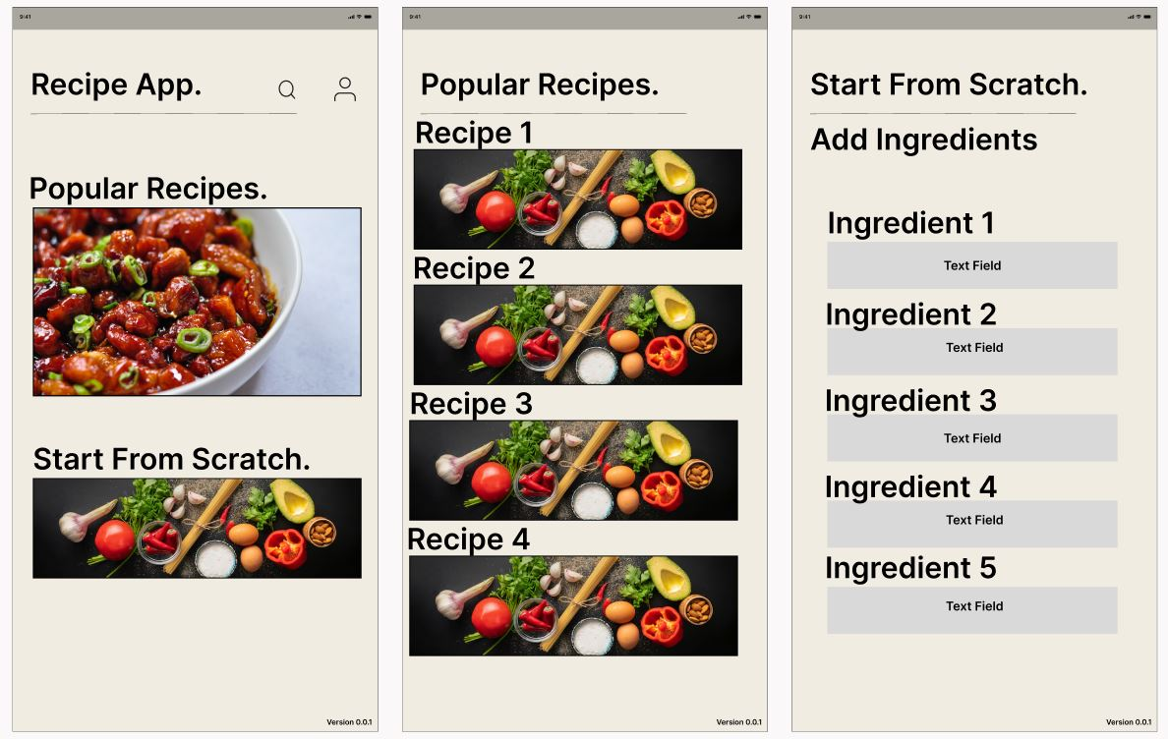
Wireframe Mock-Up
Using Figma, Roland designed an example of how the application could look based on the features that were brainstormed.

Slide 8
Key Features
The home screen features a search function, a user profile function, and two options; ‘Popular Recipes’ and ‘Start From Scratch’.
‘The Popular Recipes’ menu lists a RecyclerView of API-pulled recipes, while the ‘Start From Scratch’ menu allows the user to input ingredients for the app to suggest recipes based on the input values.

Slide 9
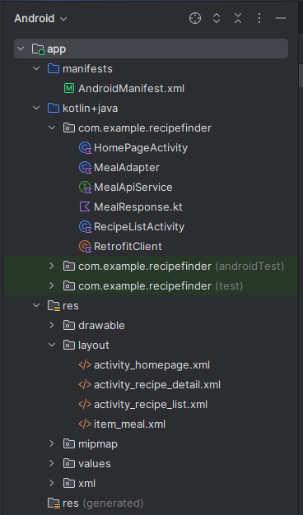
Structure of the Application
Due to time constraints, a few features couldn’t come to fruition. These features included categorizing recipes by levels of difficulty, and the ability to enter a list of ingredients and have recipes recommended to the user based on the ingredients entered.
A page for text entry was created but was left out of the final application as it served no use other than providing an error message when an ingredient was entered.
On the final application, the homepage offers a clickable photo that cycles through photos of meals that the app offers ingredients for.
The application consists of a few classes, an API interface, and a few .XML layout files.

Slide 10
Final Design – TheMealDb API
As mentioned in the previous slide - Due to time and member constraints, the final design of the application is a bare version of the wireframe mock-up. TheMealDb was used in place of Spoonacular due to ease of implementation within a short timeframe.
The final application features a “home screen” that provides a clickable RecyclerView – ImageView that cycles through various photos of recipes offered by the application (through the API). A button labeled ‘Find Your Next Favorite Recipe!’ on the home page will take the user to the next screen. This ‘RecipeListActivity’ page lists the various recipes the ‘TheMealDb’ API offers.
Minor layout customizations were made including the size and positioning of the home page to provide a clear introduction to the application. The background was changed from white to a cream color to ease eye strain due to brightness while also matching the color scheme from the wireframe mock-up.
Figma mock-up and final application were designed by Roland Gonzales.

Slide 11
Thank you.

